Slide 1
A Study of Suicide Rates
By Michelle Thorne

Slide 2

Overview
The Problem
Hypotheses
The Data
The Analysis
Findings and Further Discussions

Slide 3
The Problem

Slide 4

The Problem
Suicides represent a major mental health issue.
The Cold Hard Facts:
10th leading cause of death in the US.
In the US in 2017:
2nd leading cause of death for people ages 10-34
At least 10.5% of adults 18-25 had serious suicidal thoughts
Suicides outnumbered homicides by 2 to 1
At least 50% of people in the US know someone who has died by suicide in their lifetime
Women are 3 times more likely to attempt suicide but men are 3.5 times more likely to succeed.

Slide 5
The Hypotheses

Slide 6
Hypotheses
Have suicides significantly increased world wide from 1985-2015?
Did teenagers in 2010 commit suicide more than their counterparts in 1990? Is this statistically significant?
Do countries with a higher socio-economic status in 2015 have higher suicide rates?
If suicides increased over the last 30 years, are the suicide rates higher on specific continents? Is this statistically significant?

Slide 7
The Data

Slide 8

The Data
Suicide Rates Overview 1985 to 2016
Compares socio-economic info with suicide rates by year and country
Columns included:
Country
Year
Sex
Age
Suicide Number (suicide_no)
Population
Suicides/100k Pop
Country-year
HDI for year
GDP for year
GDP per capita
Generation

Slide 9
The Analysis

Slide 10
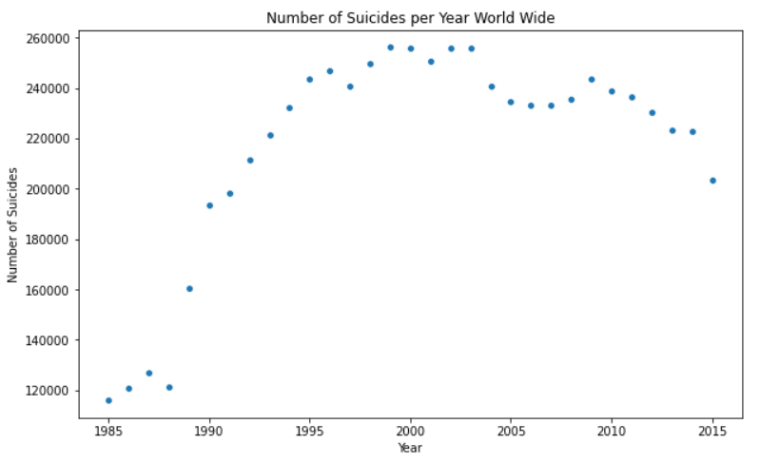
Hypothesis 1
Suicides have increased from 1985 to 2015 world wide
Totals:
1985 = 116,063
2015 = 203,640

Slide 11
Hypothesis 2
Teens committed suicide at a greater rate in 2010 than their counterparts in 1990.
Descriptive Stats of Teens in 1990
Number of Observations: 128
Minimum: 0
Maximum: 50.89
Mean: 9.12
Variance: 84.535
Skewness = 1.896
Kurtosis = 4.615
Descriptive Stats of Teens in 2010
Number of Observations: 176
Minimum: 0
Maximum: 40.82
Mean: 7.974
Variance: 76.37
Skewness = 1.748
Kurtosis = 2.88
Notes:
DescribeResult(nobs=128, minmax=(0.0, 50.89), mean=9.115156249999998, variance=84.53540312500002, skewness=1.8964333177534842, kurtosis=4.615414658680549)
DescribeResult(nobs=176, minmax=(0.0, 40.82), mean=7.973750000000001, variance=76.37093557142856, skewness=1.7481297708036412, kurtosis=2.8847404261322662)
(0.8171765804290771, 2.5256239807869285e-11)
(0.8001545071601868, 3.023125302067768e-14)

Slide 12
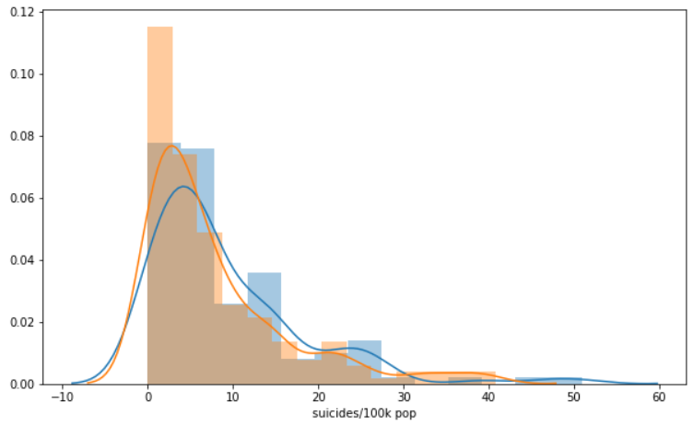
Hypothesis 2
Test for Normality:
Teens in 1990:
W value: 0.817
P-value < 0.05
Teens in 2010
W value: 0.800
P-value < 0.05
Test for Significant Difference:
(Kruskal Wallis) H statistic: 2.47
P-value: 0.116

Slide 13
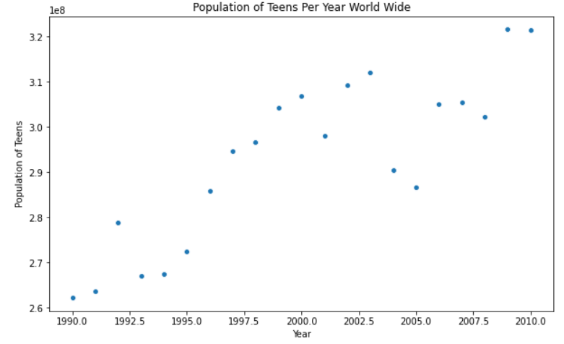
Hypothesis 2

Slide 14
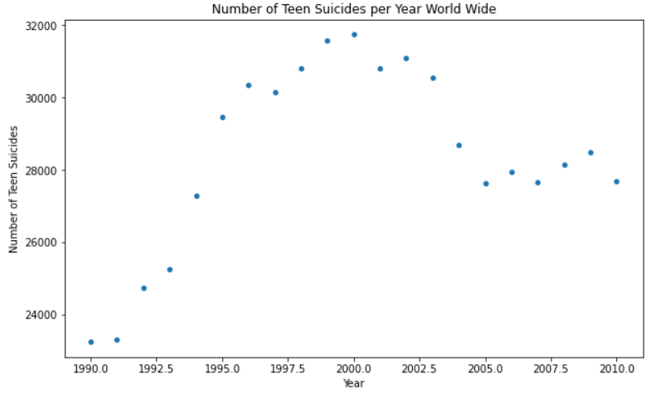
Hypothesis 2

Slide 15
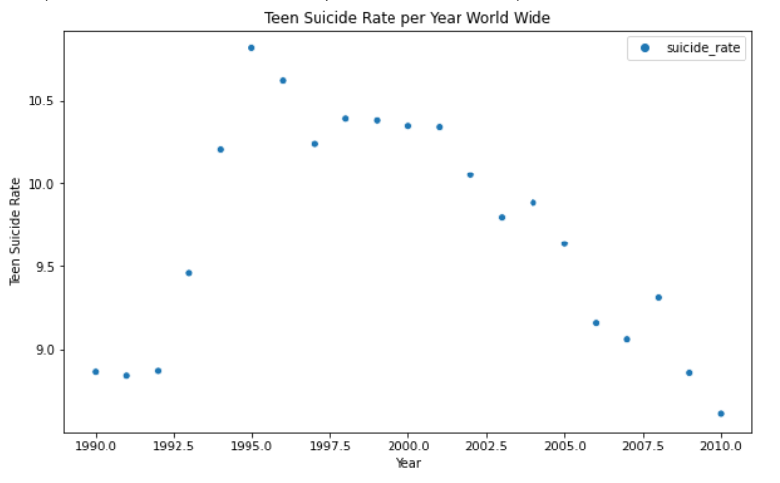
Hypothesis 2

Slide 16
What about other age ranges?

Slide 17
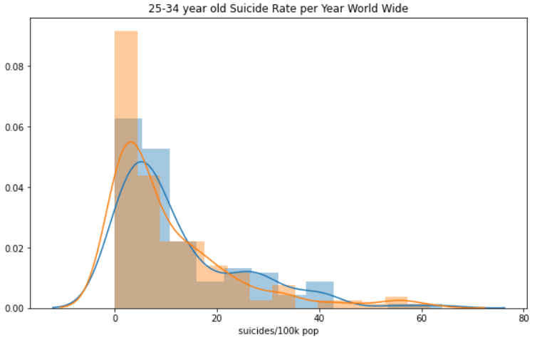
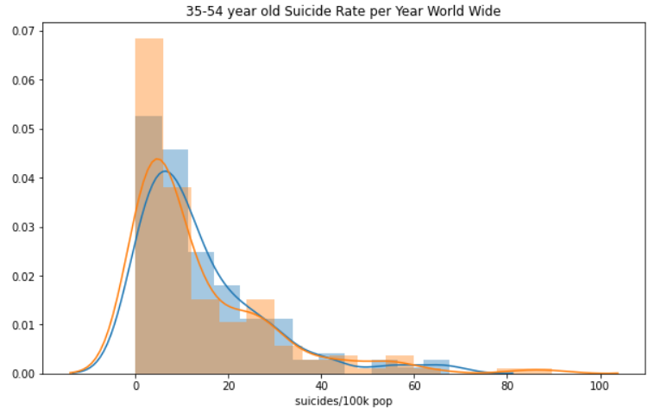
Hypothesis 2
Kruskal Wallis Test Results for 35-54 Age Range:
H stat: 1.114
P-value: 0.29118
Kruskal Wallis Test Results for 25-34 Age Range:
H stat: 2.728
P-value: 0.0986

Slide 18
Is there a difference between the age ranges?

Slide 19
Is there a significant difference in age ranges?
Kruskal Wallis Test Results for 1990:
H stat: 8.865
P-value: 0.01188
Kruskal Wallis Test Results for 2010:
H stat: 11.617
P-value: 0.003

Slide 20
What about gender?

Slide 21
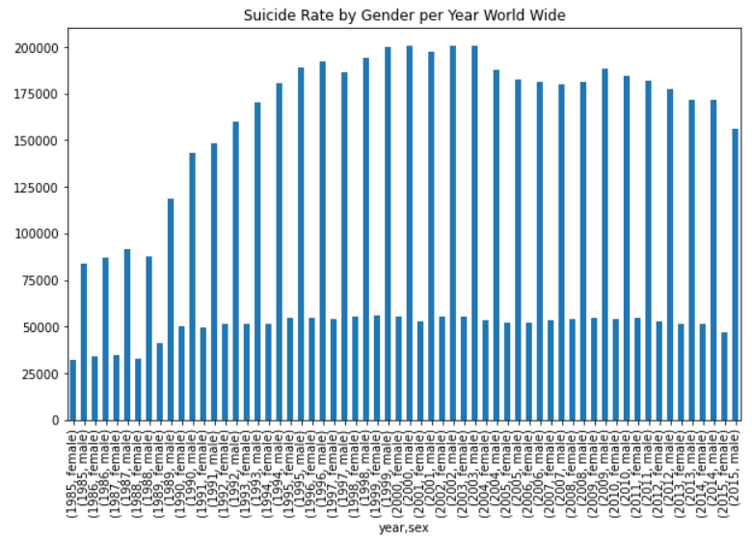

Slide 22
Hypothesis 3
There a correlation between suicide rates and GDP and/or GDP per capita for the year 2015.
Results of Correlation Tests:
Suicide Rate vs. GDP
Correlation Coefficient: 0.115
P-value: 0.375
Suicide Rate vs. GDP per Capita
Correlation Coefficient: 0.129
P-value: 0.317

Slide 23
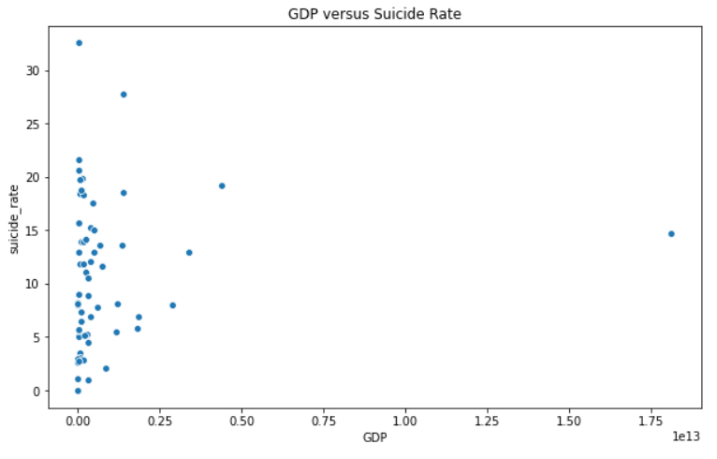
Lithuania: 32.5
United States:
$18,120,714,000,000

Slide 24
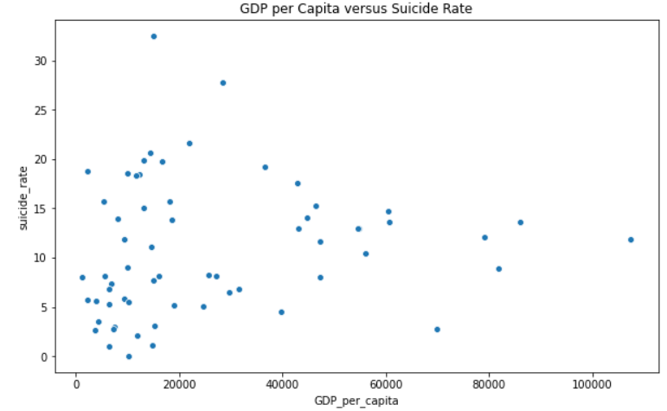
Lithuania: 32.5
Luxembourg: $107,456

Slide 25

Hypothesis 4
Suicide rates are significantly different on different continents.
Average per Continent:
Africa: 6.04
Asia: 9.204
Europe: 13.284
North America: 5.113
South America: 9.508

Slide 26
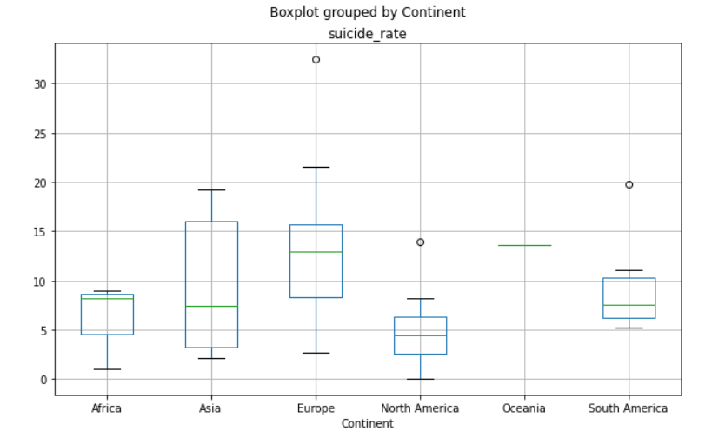
Lithuania: 32.5
Uruguay: 19.7
Cuba: 13.9

Slide 27

Hypothesis 4
Descriptive Stats show that the samples per continent are not normally distributed.
Sample sizes range from 1 to 29
Kruskal Wallis Test Results:
H-Stat: 13.197
P-value: 0.0103

Slide 28
Findings and Further Discussions

Slide 29
Findings
Hypothesis 1: Yes-Suicides increased from 1985 to 2015
Hypothesis 2:
No-there is no significant difference in suicide rate of teens between 1990 and 2010
No-there is no significant difference in suicide rate of any other age range between 1990 and 2010
Yes-there is a significant difference in suicide rate of different age ranges in 1990
Yes-there is a significant difference in suicide rate of different age ranges in 2010
Yes-there is a significant difference in suicide rate between genders
Hypothesis 3: No-there is no correlation between suicide rate and GDP or GDP per Capita
Hypothesis 4: Yes-there is a significant difference in suicide rate on different continents

Slide 30
Further Discussions
There are many reasons why a person chooses to commit suicide.
To investigate possible societal reasons:
Which continents have a higher suicide rate?
Compare the 5 countries with the highest vs. the 5 countries with the lowest suicide rate to find a connection
Find data on the “happiness” of the citizens of different countries
Compare other aspects of a country like:
Average PTO
Cost of Living
Health Care

Slide 31
Sources:
https://www.dosomething.org/us/facts/11-facts-about-suicide
https://www.kaggle.com/russellyates88/suicide-rates-overview-1985-to-2016
https://datahub.io/JohnSnowLabs/country-and-continent-codes-list#resource-country-and-continent-codes-list-csv

